Slide 1
QM69A Auto Diagnostic
Si Min

Slide 2






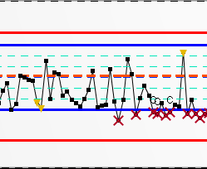


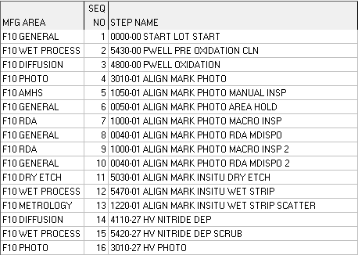
Auto-Diagnostics
Purpose: In response to repeated OOCs in charts, perform automated (1) Data Extraction and (2) Analysis to arrive at potential root causes of deviation
Chart violation Event in SPACE
Evaluate criteria for analysis
Data from existing databases
Every step analysis back to lot start
Dashboard for visualization
Information previously from Y3, DataNav
OOC/OOA/OOS
Mean, Sigma, Raw

Slide 3
Help Needed From POs
Chart trend up with OOCs
To check any toggles from current loop/incoming
PO to verify root causes diagnosed by AD
Is AD give correct root cause?
Feedback directly to AD dashboard or fill in success case info in the table
Yes
No
Continue with normal trouble shooting
Remark
AD triggered rule:
At least one ooc point in 24 hours
At least 2 ooc point in 3 days

Slide 4
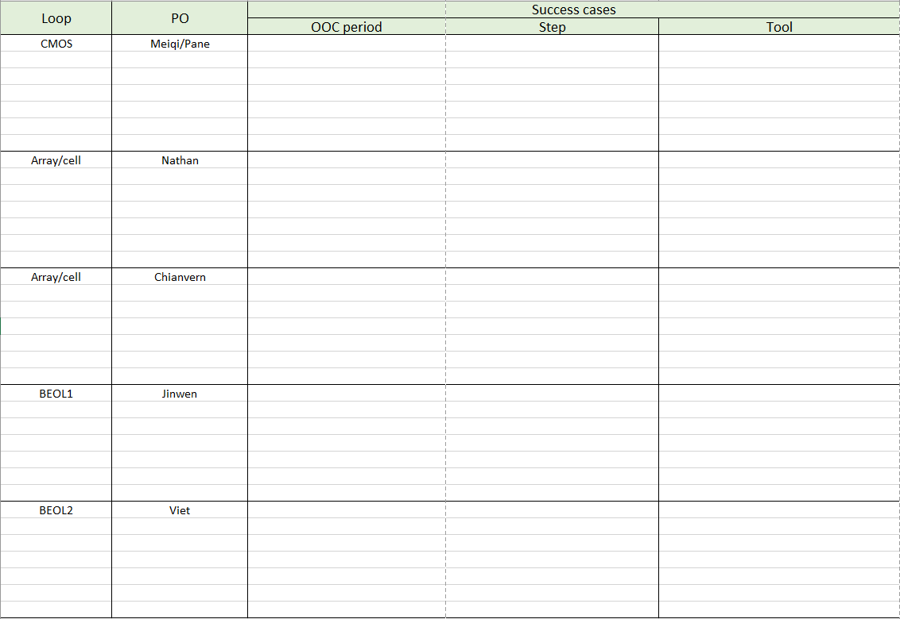
Success Cases Excel List
File location: \\NAS06A\YErda300\Auto Diagnostic\RDA PO

Slide 5
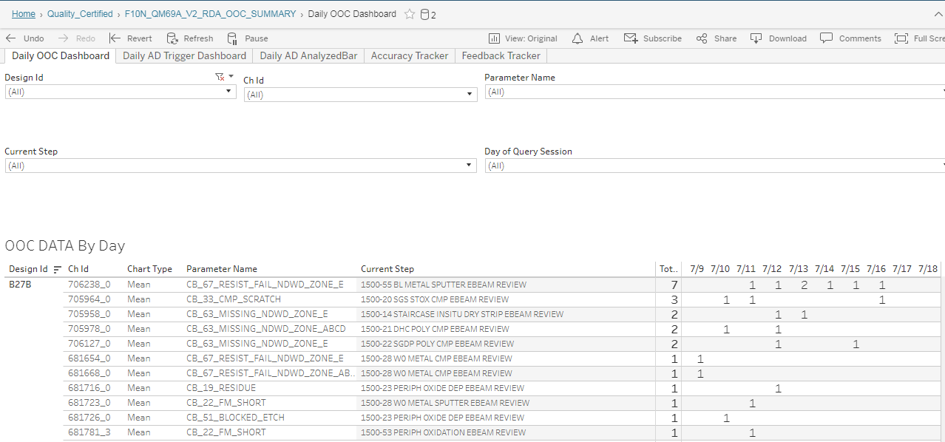
Accessing the QM69A AD Dashboard
Direct F10N Link
https://tableau-apac/#/site/F10FEMFG/views/F10N_QM69A_V2_RDA_OOC_SUMMARY/DailyOOCDashboard?:iid=3
Subscribe to receive an email daily. Link directly to the dashboard

Slide 6
Dashboard Features Introduction
Daily OOC Dashboard
It will show past OOC count for RDA charts for past 24 hours. Mainly for RDA usage and monitoring trend.

Slide 7
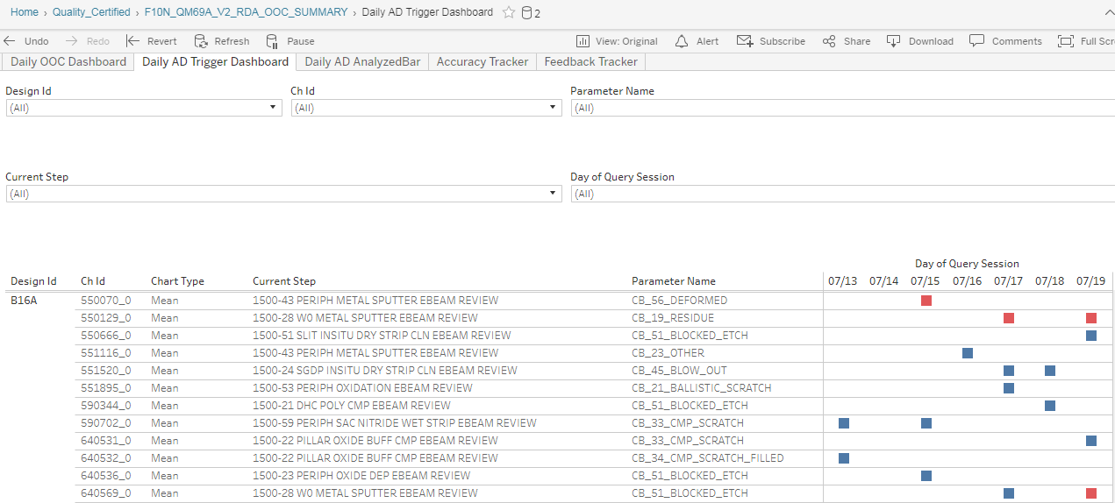
Dashboard Features Introduction
Daily AD Trigger Dashboard
It will show which charts have AD trigger based on past 24 hours OOC point
Blue square means it has been feedbacked
Red square means it does not get feedback from RDA yet

Slide 8
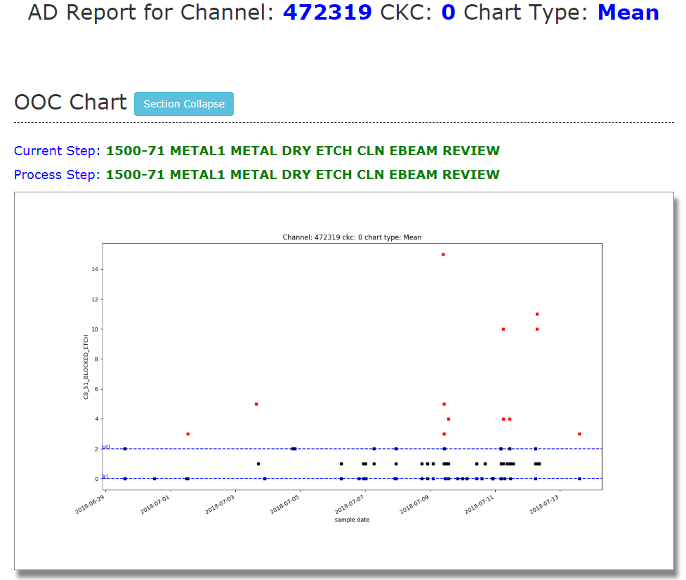
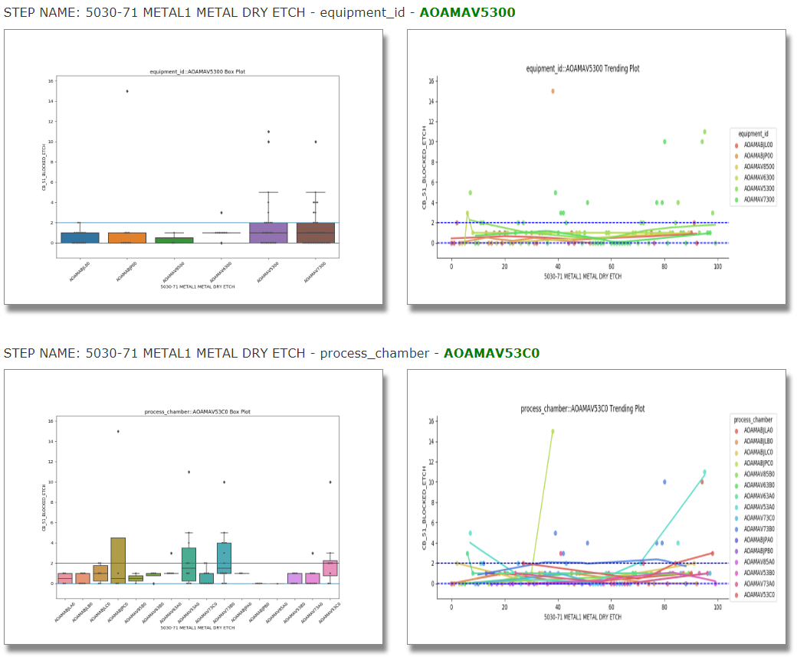
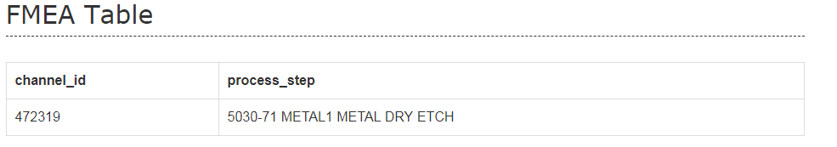
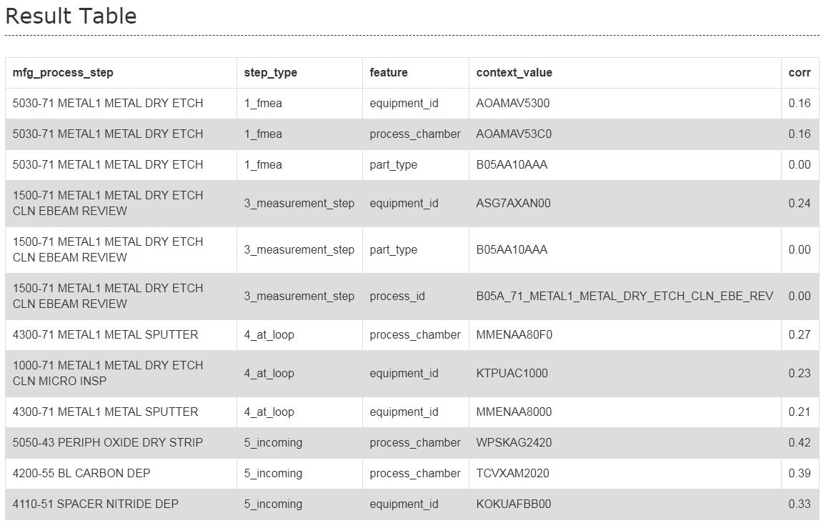
Sample Report

Slide 9

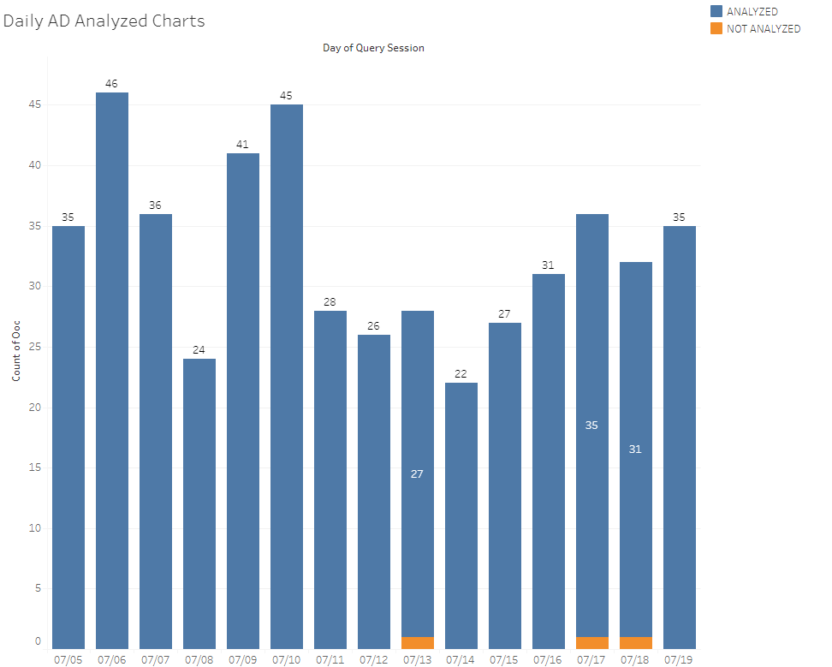
Dashboard Features Introduction
Daily AD Analyze Bar
It will show which charts have AD analyzed
Blue bar means it has been analyzed by AD
Orange bar means it is not analyzed yet
Accuracy Tracker
It will show daily/weekly accuracy
Feedback Tracker
It will show daily feedback done and contributing team members

Slide 10
Success Cases

Slide 11
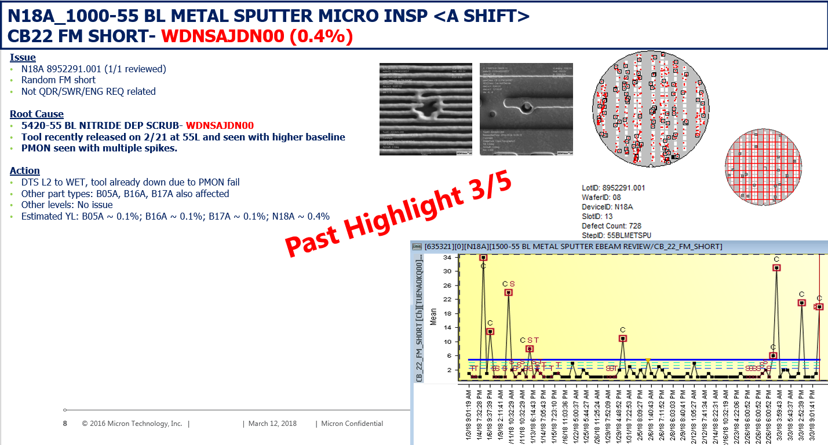
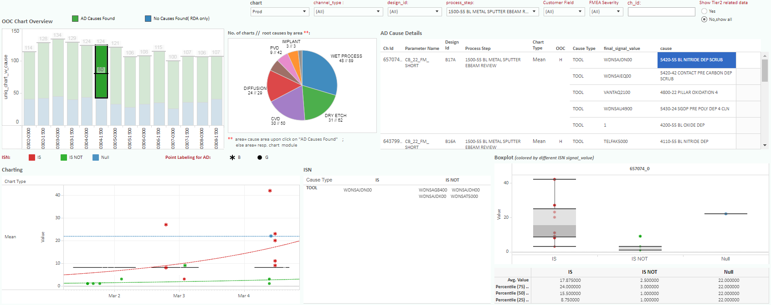

Slide 12
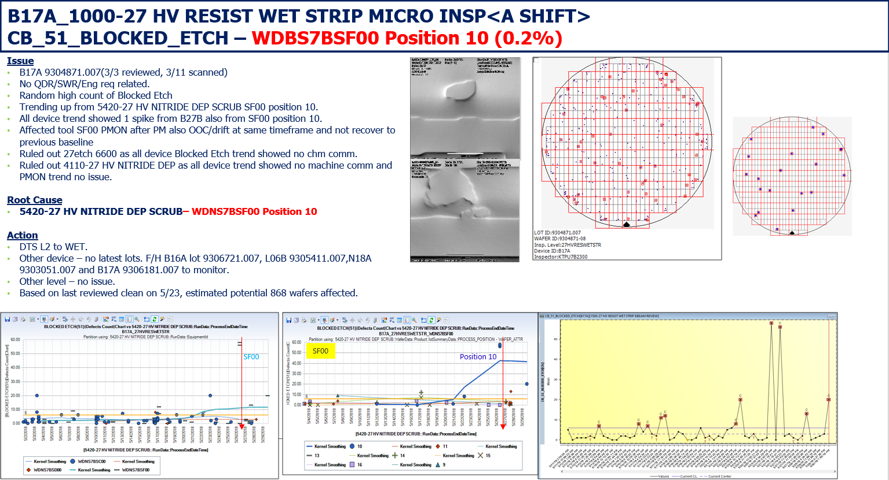
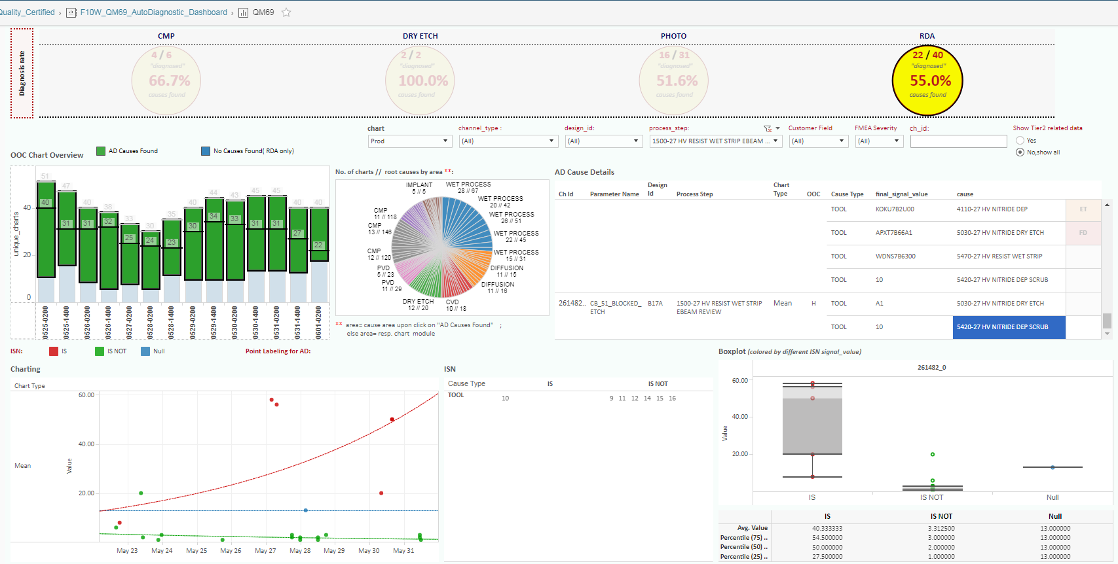
Past Highlight 5/31

Slide 13
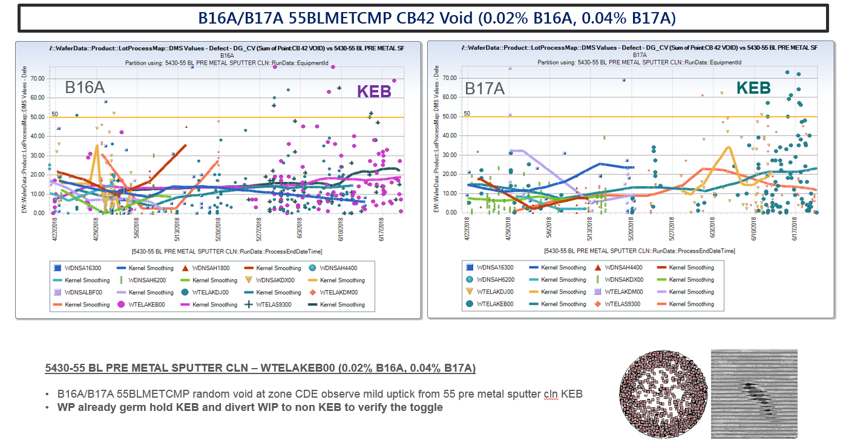
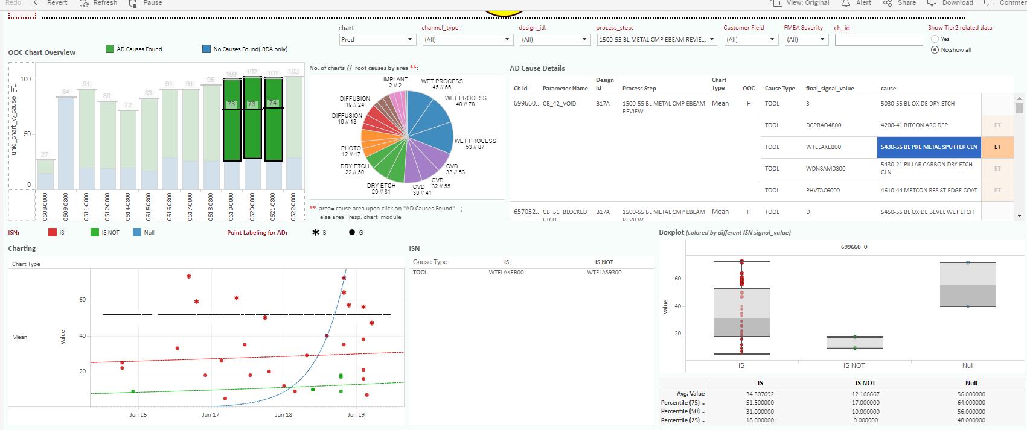
Past Highlight 6/22

Slide 14
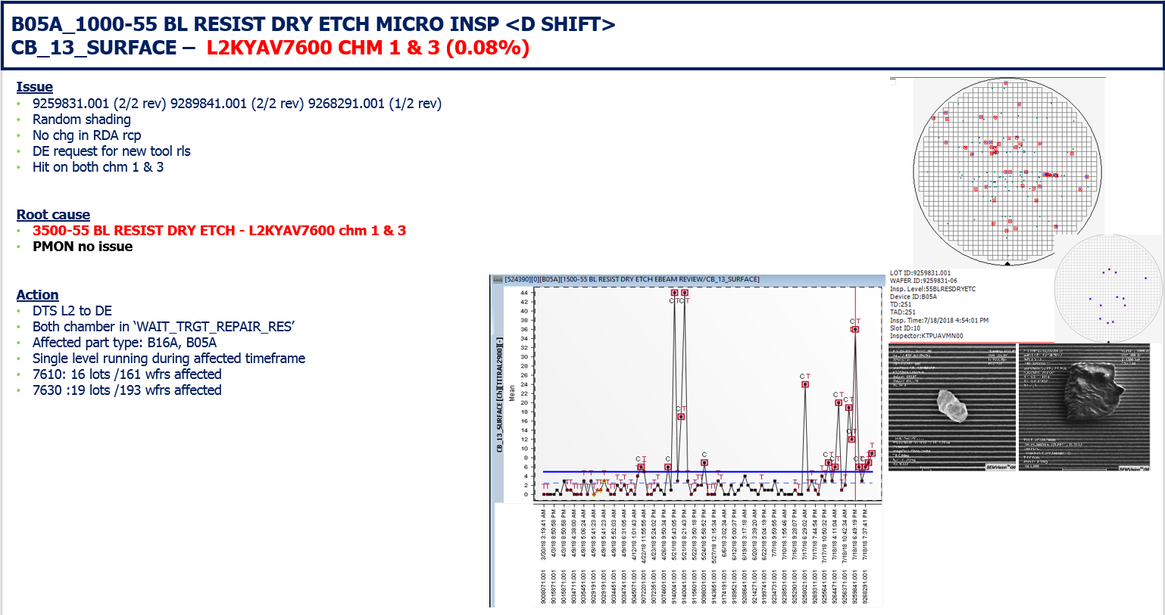
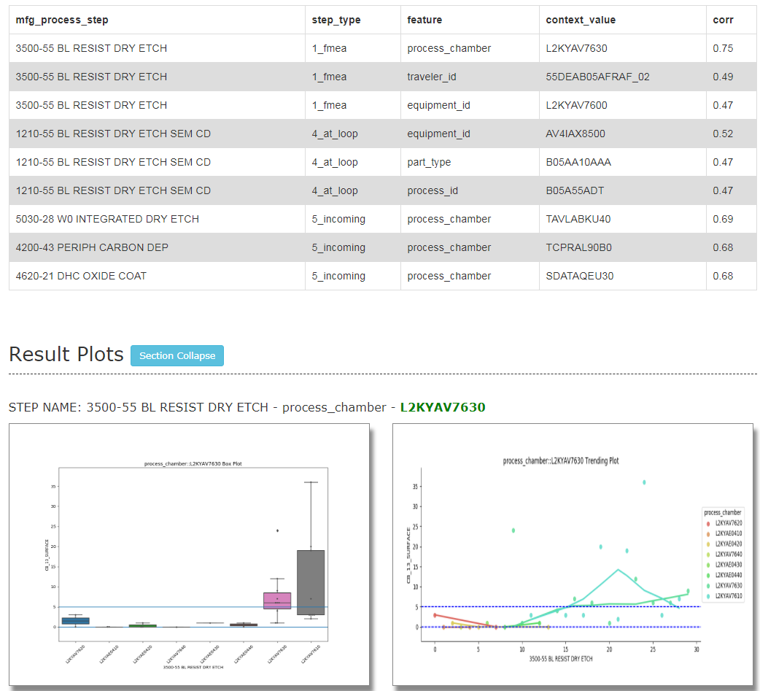
Past Highlight 7/19

Slide 15
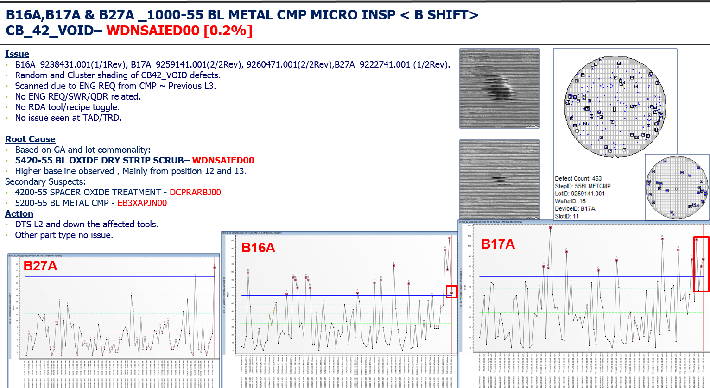
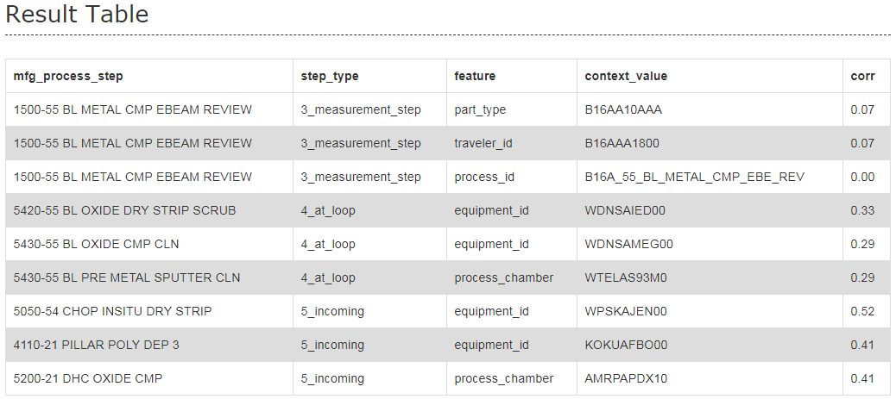
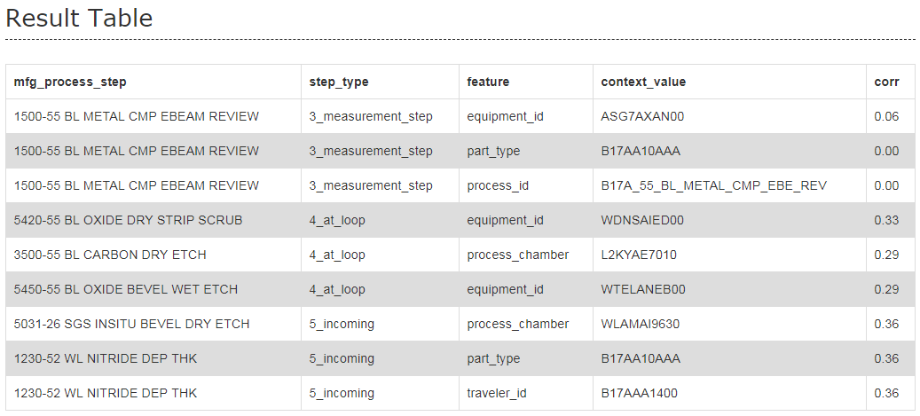
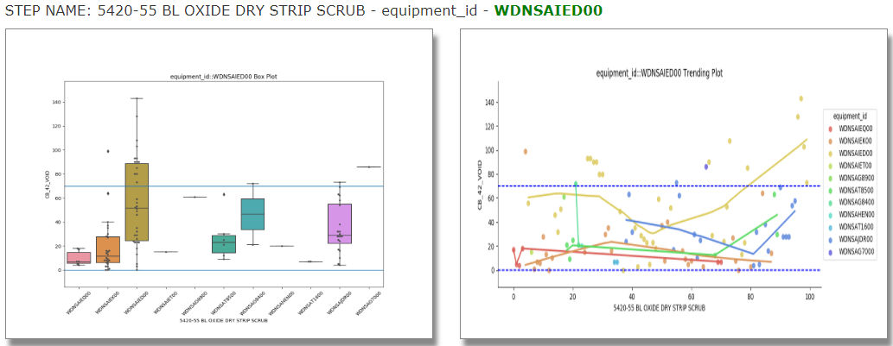
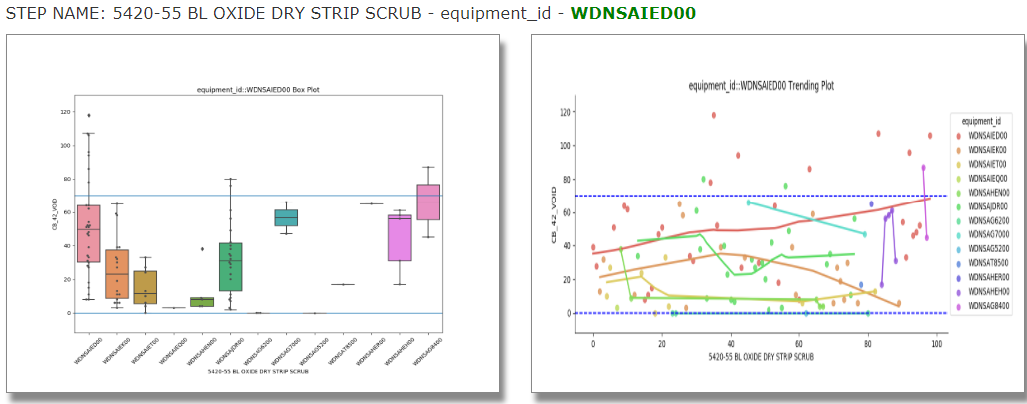
Past Highlight 7/22
B16A
B17A

